Slide 1
Securing Microsoft 365 data with service encryption
Thomas Stensitzki

Slide 2





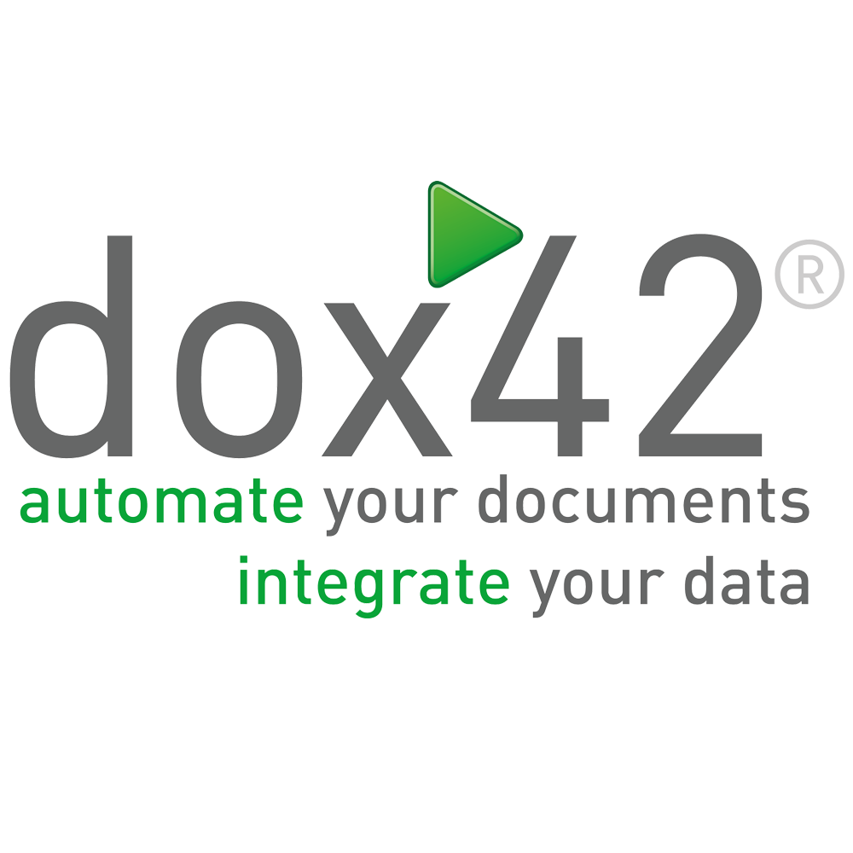
Thank You to our Sponsors…
Event Sponsor
Platinum Sponsors

Slide 3








Thank You to our Sponsors…
Gold Sponsors
Data Quality
Event Lunch
Accessibility
Data Analytics

Slide 4

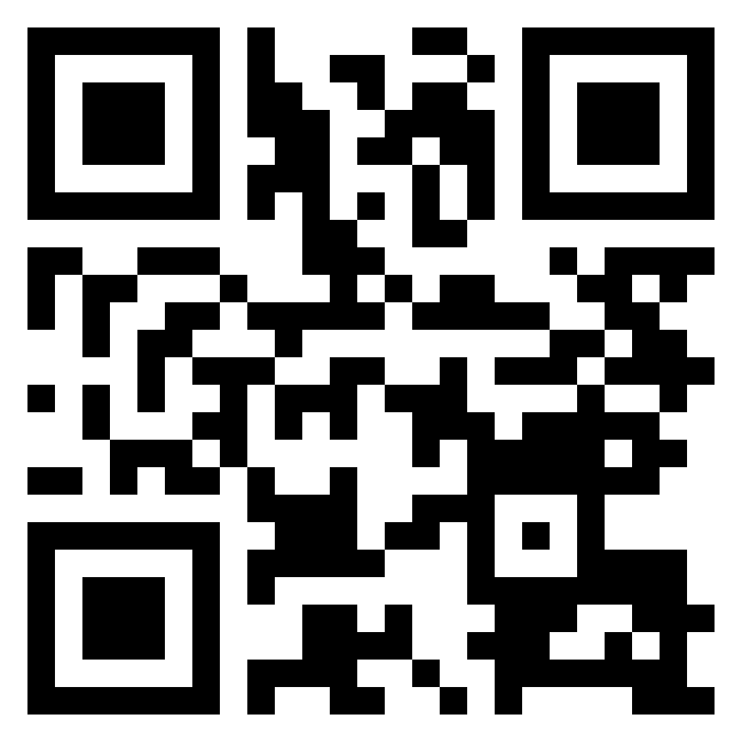
Thomas Stensitzki
Founder
Granikos
25+ years experience with Microsoft Technologies
MVP, MCT Regional Lead
Book author, blogger
“Don't dream it, be it.”

Slide 5
Agenda
What we not cover
What is Microsoft 365 Standard Encryption?
What is Customer Key?
How do you implement Customer Key?

Slide 6
What we not cover

Slide 7
What we not cover
TLS Transport encryption
Between Customer and Data Center
Between Servers in Data Center

Slide 8
What we not cover
Azure-related encryption
Blob, SQL DB, Cosmos DB, Data Lake, etc.
S/MIME Message Encryption
Office 365 Message Encryption aka OME, now Microsoft Purview Message Encryption
Sensitivity Label-based encryption
Additional information

Slide 9
What is Microsoft 365 Standard Encryption?

Slide 10
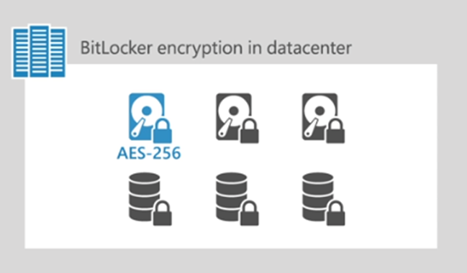
Microsoft 365 Encryption
Microsoft 365 Standard
BitLocker → Filesystem encryption in Microsoft data centers
Shredded Storage → File chunk encryption with AES-256 keys

Slide 11




Shredded Storage in SharePoint Online
Encrypted Files
Azure Storage Containers
Key Store
Content Database
Chunks
https://aka.ms/dataencryption
Notes:
https://docs.microsoft.com/en-us/microsoft-365/compliance/data-encryption-in-odb-and-spo?view=o365-worldwide
https://aka.ms/dataencryption

Slide 12
Microsoft Purview Customer Key
Previously known as Customer Managed Key aka CMK

Slide 13
Why Customer Key
Additional encryption layer on top of BitLocker
Access separation for system administrators
Dedicated compliance requirements for data encryption
Customer-based key management

Slide 14
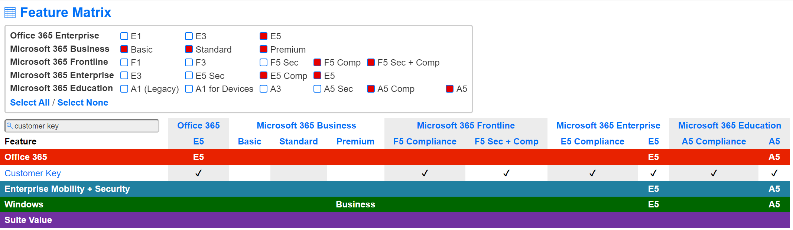
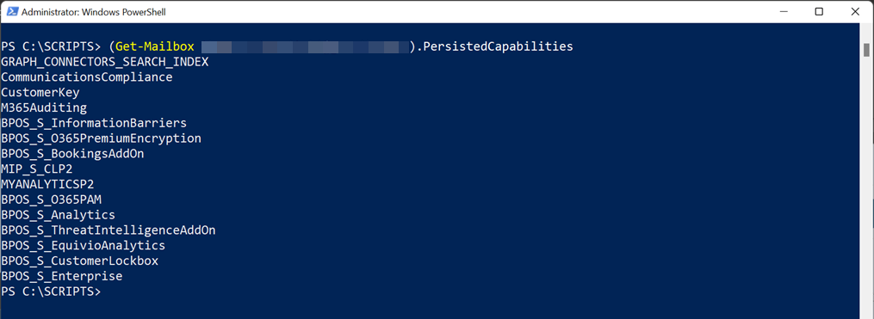
Licensing
https://m365maps.com
Exchange Online Management Shell

Slide 15
The Basics
Azure Key Vaults in two separate Azure subscriptions
Enterprise Agreement (EA) or Cloud Solution Provider (CSP)
Initial CMK setup in FastTrack Portal
Key encryption options
General Microsoft 365 Data-at-Rest encryption
Exchange Online mailbox and SharePoint Online encryption (incl. OneDrive and Microsoft Teams)

Slide 16
The Basics
Usage
Create a Data Encryption Policy (DEP)
Assign a DEP to your tenant, a user, or a SharePoint site
Management
Customer Key rotation
Availability Key rotation → No direct control by customer
Additional information

Slide 17
The Notes
Do not delete keys associated with an active policy, or a policy assigned to resources on hold
A key rotation triggers a decryption and re-encryption using the key

Slide 18
The Notes
Exchange Online
Encryption requires an assigned license with Customer Key
Inactive mailboxes may still use an old encryption key
SharePoint Online
Backup sets might contain data protected by an old encryption key
Constant risk of belated data loss due to deleted keys

Slide 19
Key Management
On-Premises Hardware Service Module (HSM)
Recommended for production use
Azure Key Vault Key
Recommended for testing or proof-of-concept scenarios
Both variants require Azure Key Vault for configuration an management

Slide 20
Microsoft 365 Data-at-Rest
Tenant-wide data protection policy
Teams
Chat messages (1:1 chats, group chats, meeting chats, channel conversations)
Media messages (images, code examples, video/audio message, wiki pictures)
Chat notifications and chat recommendations by Cortana
Status messages

Slide 21
Microsoft 365 Data-at-Rest
Exchange Online
User and signal information
Mailboxes that do not use a dedicated encryption policy
Microsoft Information Protection
Exact Data Match (EDM) data of sensitive information types
Sensitivity Label
Notes:
More on exact data match https://docs.microsoft.com/microsoft-365/compliance/sit-get-started-exact-data-match-based-sits-overview?view=o365-worldwide&WT.mc_id=M365-MVP-5003086

Slide 22
Microsoft 365 Data-at-Rest
Encrypts
New Teams and EDM data after DEP assignment
Exchange Online mailbox content completely

Slide 23
Microsoft 365 Data-at-Rest
Does not encrypt
SharePoint Online and OneDrive
Teams files and recordings in SharePoint Online and OneDrive
Teams Live Event data
Other Microsoft 365 workload data, e.g., Yammer or Planner
Multiple Microsoft 365 Data-at-Rest DEP can exist in a tenant
Only one DEP is actively assigned and in use

Slide 24
Exchange Online
Supported Exchange Recipient Objects
Mailbox user
Mail user
Microsoft 365 Groups
Shared mailboxes
Public folders
One assigned DEP per object
Max 50 concurrent active DEP per tenant

Slide 25
Exchange Online und Microsoft Teams
Root Keys
2 Customer Keys Azure Key Vault
Availability Key Office 365
RSA
AES 256
Data Encryption Policy Key Based on root keys
AES 256
Mailbox Key
Based on Data Encryption Policy key
AES 256
Mailboxes

Slide 26
SharePoint Online
Encryption of existing files starts rights after key assignment
Encrypt content with different keys per Geo-location
Notes:
More on exact data match https://docs.microsoft.com/microsoft-365/compliance/sit-get-started-exact-data-match-based-sits-overview?view=o365-worldwide&WT.mc_id=M365-MVP-5003086

Slide 27
SharePoint Online
Root Keys
2 Customer Keys Azure Key Vault
Availability Key Office 365
RSA
AES 256
Tenant Intermediate Key Based on Root-Keys
AES 256
Site Encryption Key Based on Tenant Intermediate Key
AES 256
1 File = N Chunks = N Keys
File Chunk Encrpytion Key
Based on Site Encryption Key
AES 256
Data Chunks

Slide 28
Implementing CMK

Slide 29




Prepare for FastTrack
Create Azure key vaults in two Azure subscriptions
One key vault with one key per workload to encrypt
Azure Subscriptions
Subscription A
Subscription B
Key Vaults
KV-M365-A
KV-EXO-A
KV-SPO-A
KV- M365-B
KV-EXO-B
KV-SPO-B
Keys
KEY- M365-A
KEY- EXO-A
KEY- SPO-A
KEY- M365-B
KEY- EXO-B
KEY- SPO-B

Slide 30
Prepare for FastTrack
Create Azure key vaults in two Azure subscriptions
One key vault with one key per workload to encrypt
Azure Subscriptions
Subscription A
Subscription B
Key Vaults
KV-M365-A
KV-EXO-A
KV-SPO-A
KV- M365-B
KV-EXO-B
KV-SPO-B
Keys
KEY- M365-A
KEY- EXO-A
KEY- SPO-A
KEY- M365-B
KEY- EXO-B
KEY- SPO-B
1 Key Pair per Workload

Slide 31
Configuration
Create new Azure AD security groups for key vault
Administrator + Contributors
Create two new Azure subscriptions
Separation of Azure resource group, key vault, and key permissions
Use meaningful names, e.g., AZ-EGXDE-CMK-A,
Register your tenant for Customer Key in FastTrack
Key vault and key names are globally unique

Slide 32
Configuration
Create a resource group per workload to encrypt in each subscription
Create a key vault per resource group
Standard (Test, Proof-of-Concept), or Premium (Production)
Configuration of access permissions per key vault using previously created security groups
Create keys in key vault

Slide 33
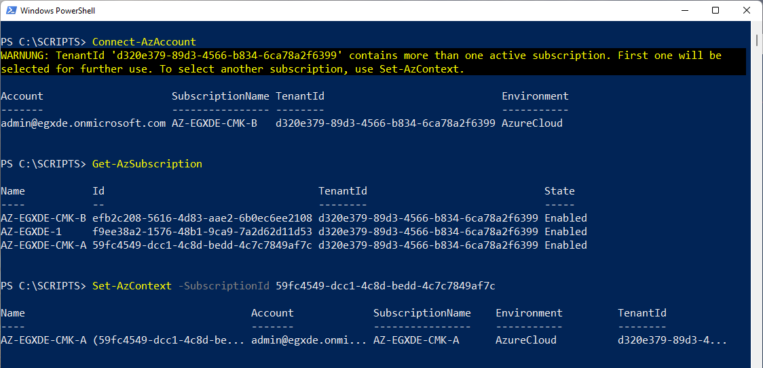
Configuration

Slide 34
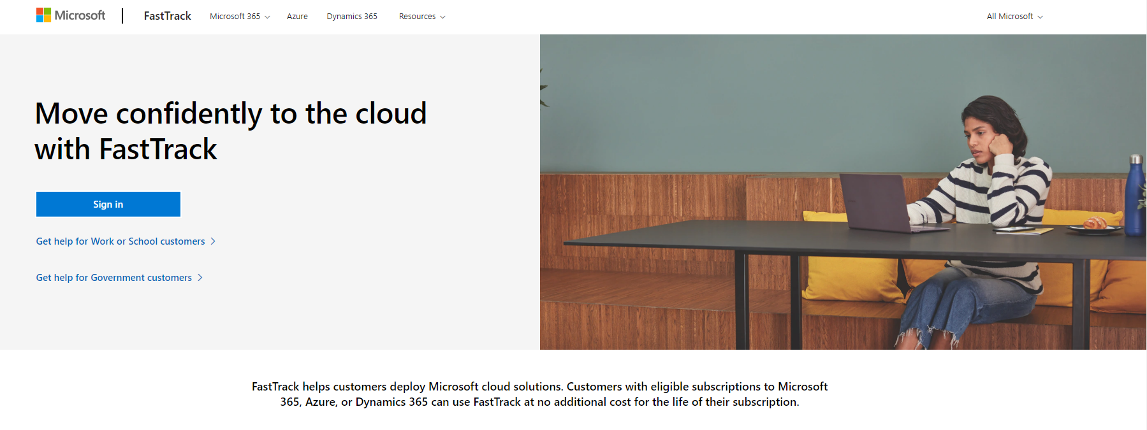
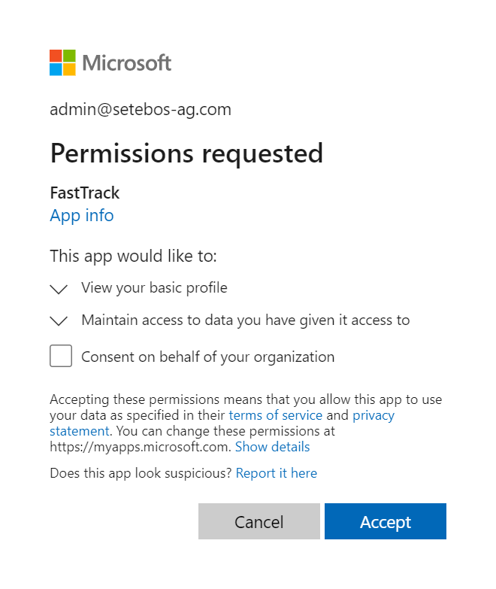
FastTrack
https://fasttrack.microsoft.com

Slide 35
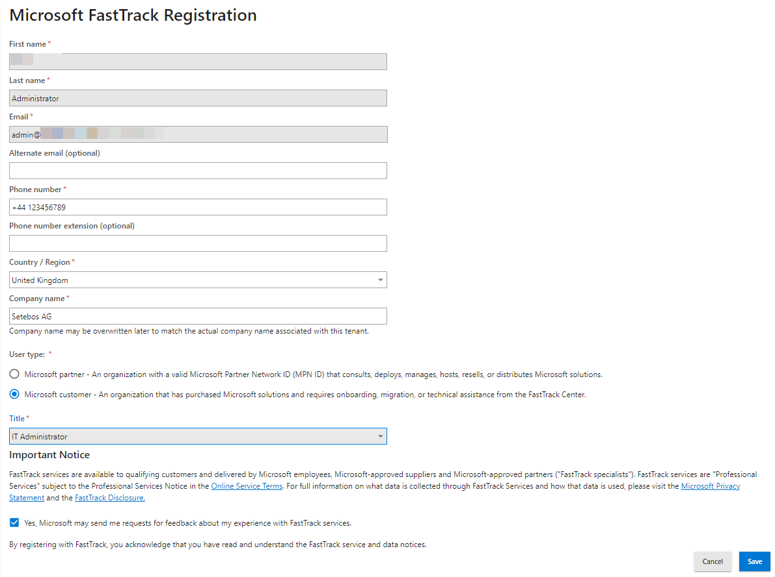
FastTrack

Slide 36
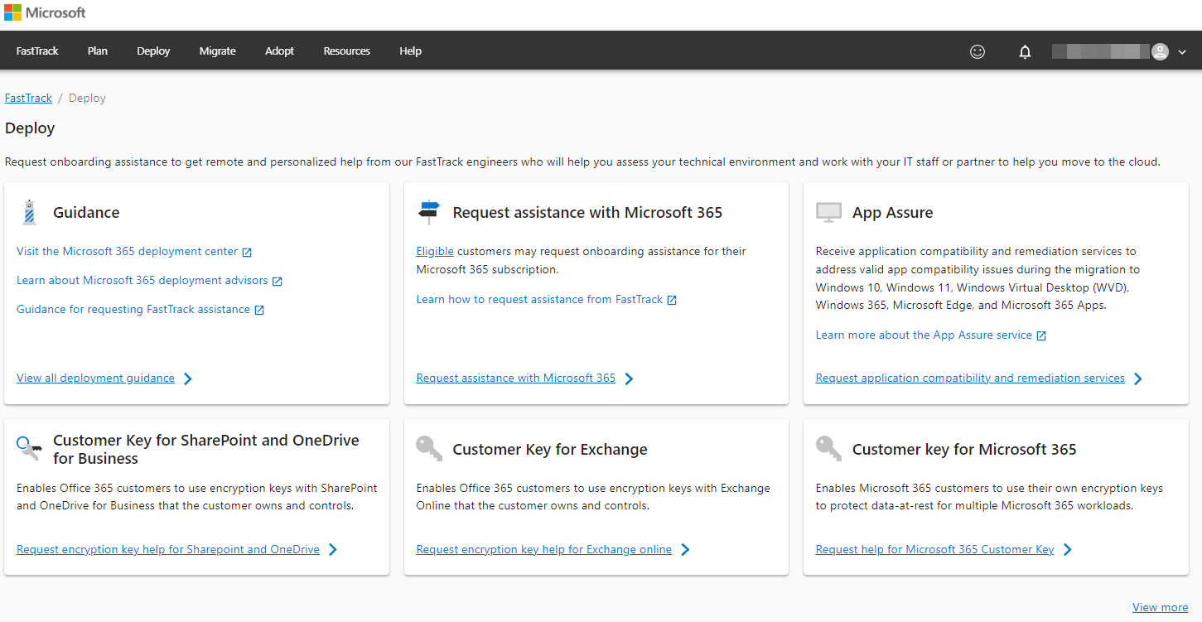
FastTrack

Slide 37
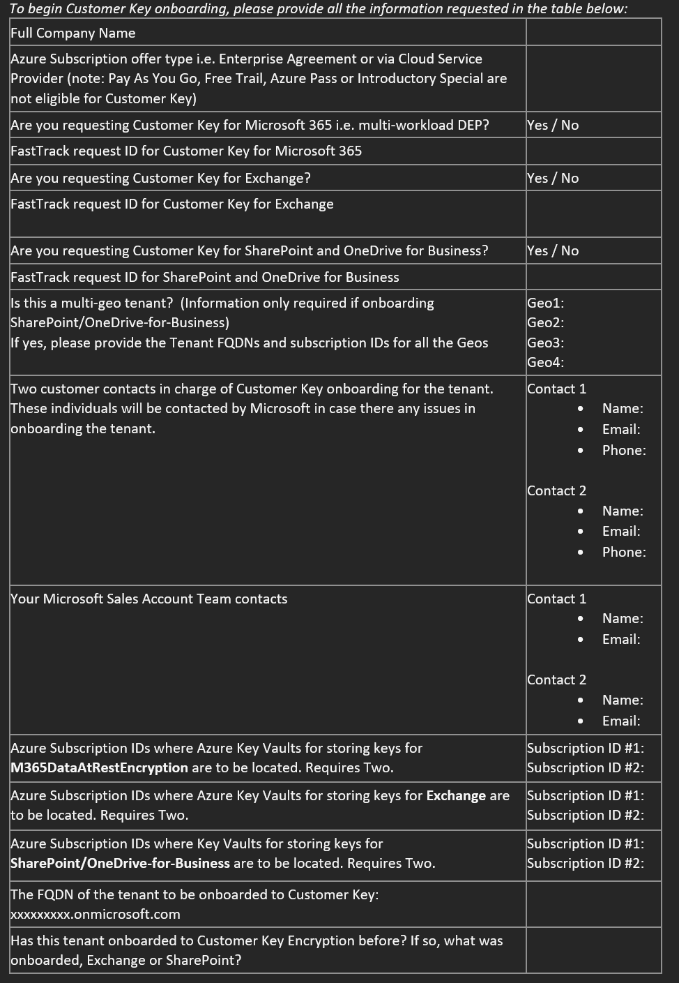
FastTrack

Slide 38
Create Key Vault
# Registration provider feature MandatoryRetentionPeriod
# Prevents accidental deletion of the Azure subscription Register-AzProviderFeature -FeatureName mandatoryRetentionPeriodEnabled -ProviderNamespace Microsoft.Resources
# Register KeyVault provider namespace
Register-AzResourceProvider -ProviderNamespace Microsoft.KeyVault
# Create resource resource group for Azure key vaults
New-AzResourceGroup -Name RG-EGXDE-KV-A -Location "West Europe"
# Create first key vault in Azure Portal
# Save template and parameter file for additional key vaults
Query Azure locations
Get-AzLocation

Slide 39
Create Key Vault
# Parameter file praparation
"parameters": {
"name": {
"value": "az-kv-egxde-exo-a"
{…}
"accessPolicies": {
"value": [
{
"objectId": "754e1dbe-1bcf-4789-bbee-22410877fdb0",
"tenantId": "d320e379-89d3-4566-b834-6ca78a2f6399",
# Load template file and convert to JSON $TemplateFile = [System.IO.File]::ReadAllText("C:\CMK\keyvault-template.json") $TemplateJson = ConvertFrom-Json $TemplateFile –AsHashtable
# Create a new resource group
New-AzResourceGroupDeployment -ResourceGroupName "RG-EGXDE-KV-A" -TemplateObject ` $TemplateJson -TemplateParameterFile "C:\CMK\keyvault-parameters-exo-a.json"
Key vault names are globally unique

Slide 40
Configure Key Vault Permissions
# Variables for key vault and admin security group
$kvName = 'az-kv-egxde-exo-a'
$kvAdminGroup = 'kv-Admins'
# Assing access policy for administrators
Set-AzKeyVaultAccessPolicy -VaultName $kvName `
-ObjectId (Get-AzADGroup -SearchString $kvAdminGroup)[0].Id `
-PermissionsToKeys create,import,list,get,backup,restore
# Configure contributors access via Azure Portal

Slide 41
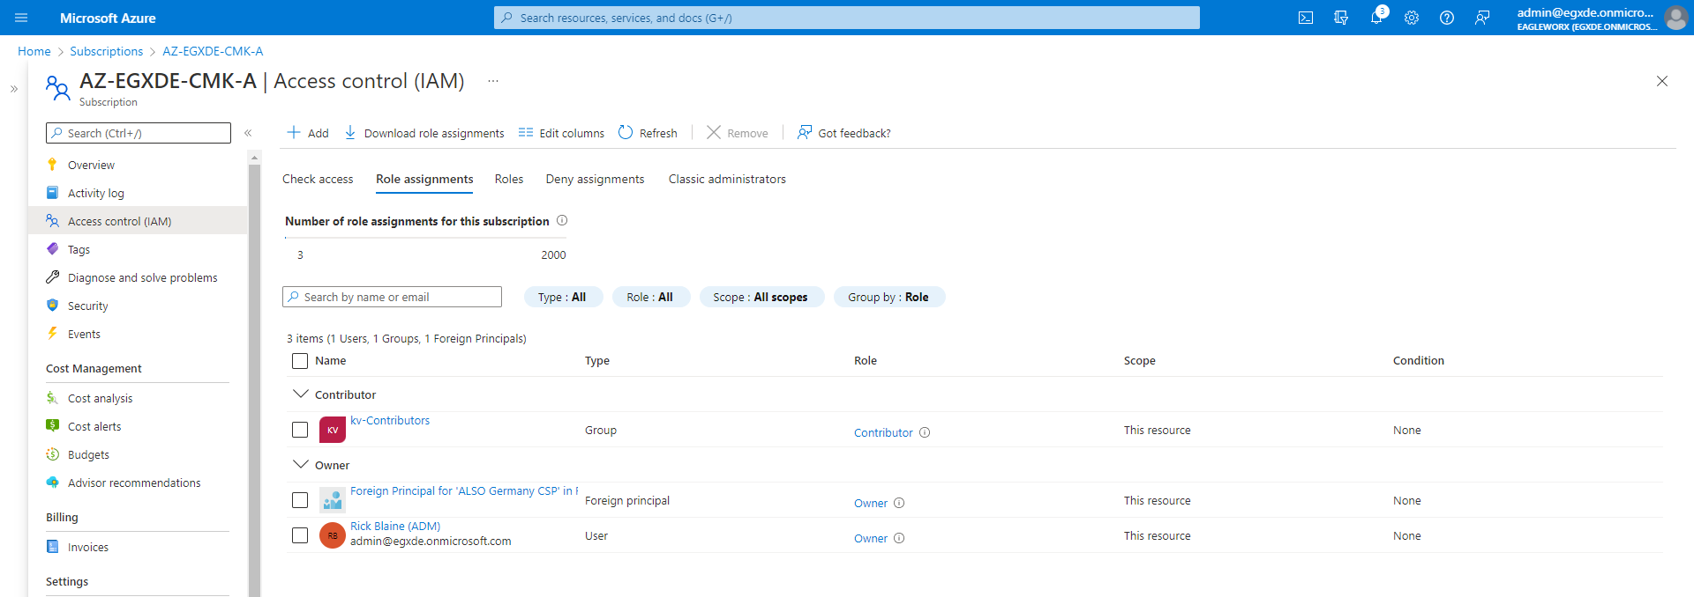
Configure Key Vault Permissions
# Variables for key vault and admin security group
$kvName = 'az-kv-egxde-exo-a'
$kvAdminGroup = 'kv-Admins'
# Assing access policy for administrators
Set-AzKeyVaultAccessPolicy -VaultName $kvName `
-ObjectId (Get-AzADGroup -SearchString $kvAdminGroup)[0].Id `
-PermissionsToKeys create,import,list,get,backup,restore
# Configure contributors access via Azure Portal

Slide 42
Configure Key Vault Permissions
# Key vault variable
$kvName = 'az-kv-egxde-exo-a'
# Microsoft 365 service principals
$objExoSfB = '00000002-0000-0ff1-ce00-000000000000'
$objSpoTeams = '00000003-0000-0ff1-ce00-000000000000'
$objMultiWL = 'c066d759-24ae-40e7-a56f-027002b5d3e4'
# Exchange Online / Skype for Business
Set-AzKeyVaultAccessPolicy -VaultName $kvName -PermissionsToKeys wrapKey,unwrapKey,get `
-ServicePrincipalName $objExoSfB
# SharePoint Online / OneDrive for Business / Teams Files
Set-AzKeyVaultAccessPolicy -VaultName $kvName -PermissionsToKeys wrapKey,unwrapKey,get `
-ServicePrincipalName $objSpoTeams
# Microsoft 365 Multi-Workload
Set-AzKeyVaultAccessPolicy -VaultName $kvName -PermissionsToKeys wrapKey,unwrapKey,get `
-ServicePrincipalName $objMultiWL

Slide 43
Create Keys
# Key vault name
$kvName1 = 'az-kv-egxde-exo-a'
$kvName2 = 'az-kv-egxde-spo-a'
$kvName3 = 'az-kv-egxde-m365-a'
# Exchange Online / Skype for Business
Add-AzKeyVaultKey -VaultName $kvName1 -Name 'egxde-exo-key-a' -Destination 'Software'
# SharePoint Online / OneDrive for Business / Teams Files
Add-AzKeyVaultKey -VaultName $kvName2 -Name 'egxde-spo-key-a' -Destination 'Software'
# Microsoft 365 Multi-Workload
Add-AzKeyVaultKey -VaultName $kvName3 -Name 'egxde-m365dr-key-a' -Destination 'Software'
Key names are globally unique

Slide 44
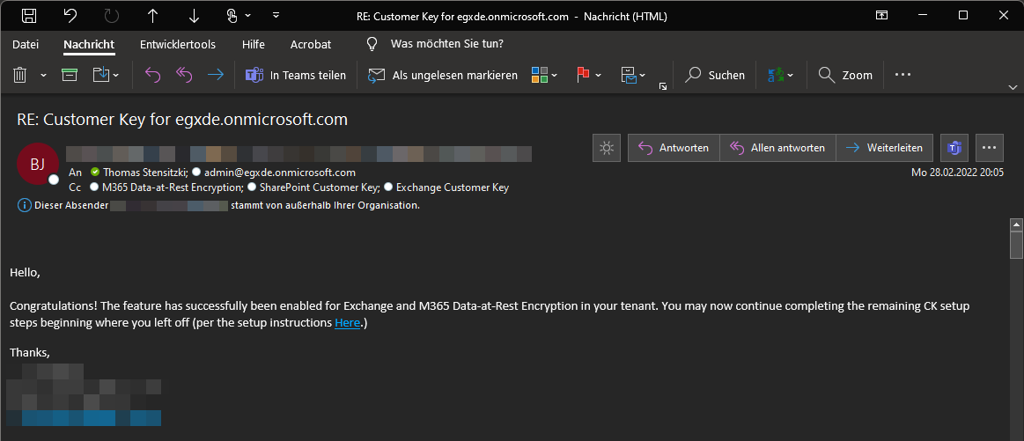
Email-based FastTrack communication

Slide 45
Data Encryption Policies

Slide 46
Multi-Workload
# PowerShell module: ExchangeOnlineManagement
Connect-ExchangeOnline
# Variables
$key1 = 'https://az-kv-egxde-m365dr-a.vault.azure.net:443/keys/egxde-m365dr-key-a'
$key2 = 'https://az-kv-egxde-m365dr-b.vault.azure.net:443/keys/egxde-m365dr-key-b'
# Create new multi-workload data encryption policy
New-M365DataAtRestEncryptionPolicy -Name 'EGX_DataAtRest' `
-AzureKeyIDs $key1,$key2 -Description 'EGX Data at Rest Multi-Workload policy'
# Assign maulti-workload data encryption policy at tenant level
Set-M365DataAtRestEncryptionPolicyAssignment -DataEncryptionPolicy 'EGX_DataAtRest'

Slide 47
Multi-Workload
Get-M365DataAtRestEncryptionPolicyAssignment | fl
RunspaceId : 1d83f812-f929-4eb3-bd5d-881184373ba1
OrgHierarchyToIgnore :
IsDeleted : False
Rdn : CN=EGX_DataAtRest
Parent : egxde.onmicrosoft.com\CKaaS Data Encryption Policies
Depth : 8
DistinguishedName : CN=EGX_DataAtRest,CN=CKaaS Data Encryption Policies,CN=Configuration,CN=egxde.onmicrosoft.com,CN=ConfigurationUnits,DC=DEUP281A001,DC=PROD,DC=OUTLOOK,DC=COM
IsRelativeDn : False
DomainId : DEUP281A001.PROD.OUTLOOK.COM
PartitionGuid : 59ce2f71-eaa2-4ddf-a4fa-f25069d0b324
PartitionFQDN : DEUP281A001.PROD.OUTLOOK.COM
ObjectGuid : 05a9e413-6822-4918-8d8c-99b1aba1e06c
Name : EGX_DataAtRest
SecurityIdentifierString :

Slide 48
Exchange Online
# Variables
$key1 = 'https://az-kv-egxde-exo-a.vault.azure.net:443/keys/egxde-exo-key-a'
$key2 = 'https://az-kv-egxde-exo-b.vault.azure.net:443/keys/egxde-exo-key-b'
# Create new Exchange Online data encryption policy
New-DataEncryptionPolicy -Name 'EGX_EXO_DEP' `
-AzureKeyIDs $key1,$key2 `
-Description 'EGX Exchange Online Encryption Policy'
# Assign Exchange Online DEP to different objects
Set-Mailbox LouisR@varunagroup.de -DataEncryptionPolicy 'EGX_EXO_DEP'
Set-Mailbox LouisR@varunagroup.de -DataEncryptionPolicy 'EGX_EXO_DEP' -PublicFolder
Set-MailUser OnPremUser@varunagroup.de -DataEncryptionPolicy 'EGX_EXO_DEP'
Set-UnifiedGroup SomeGroup@groups.varunagroup.de -DataEncryptionPolicy 'EGX_EXO_DEP'
# Verification for mailbox user
Get-MailboxStatistics UPN | FL IsEncrypted

Slide 49
SharePoint Online
# PowerShell Module: Microsoft.Online.SharePoint.PowerShell
Connect-SPOService -Url https://tenant-admin.sharepoint.com
# Query Azure key vault key versions
Set-AzContext –SubscriptionId SUBSCRIPTION-A
$key1version = (Get-AzKeyVaultKey -VaultName az-kv-egxde-spo-a -Name egxde-spo-key-a `
-IncludeVersions).Version
Set-AzContext –SubscriptionId SUBSCRIPTION-B
$key2version = (Get-AzKeyVaultKey -VaultName az-kv-egxde-spo-b -Name egxde-spo-key-b `
-IncludeVersions).Version
# Create SharePoint Online data encryption policy
Register-SPODataEncryptionPolicy -PrimaryKeyVaultName 'az-kv-egxde-spo-a' -PrimaryKeyName 'egxde-spo-key-a' -PrimaryKeyVersion $key1version -SecondaryKeyVaultName 'az-kv-egxde-spo-b' -SecondaryKeyName 'egxde-spo-key-b' -SecondaryKeyVersion $key2version
# Verify
Get-SPODataEncryptionPolicy

Slide 50
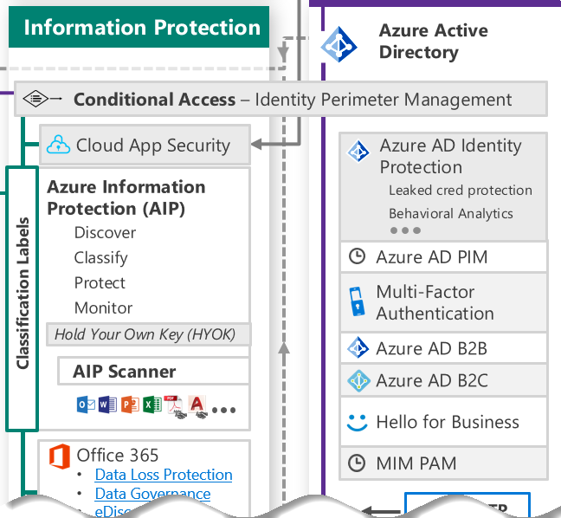
Double Key Encryption
Encryption of a subset highly sensitive date stored in Microsoft 365
Sensitivity Label-based information protection
Hardware Security Module (HSM)
e.g., Thales
Compilation of DKE GitHub Repository
https://aka.ms/MCRA
Notes:
Microsoft Cybersecurity Reference Architectures

Slide 51
Double Key Encryption
Not supported in
Transport rules, incl. anti-malware and anti-spam for message content
Microsoft Delve
eDiscovery
Content search and indexing
Office Web Apps and co-authoring

Slide 52
Summary

Slide 53
Summary
Microsoft Purview Customer Key supports three encryption targets
Microsoft 365 Data-at-Rest → tenant-wide
Exchange Online → per recipient type object
SharePoint Online → per SharePoint Geo
Not all Microsoft 365 workloads support customer key encryption
Customer key requires appropriate license plans

Slide 54
Summary
At least two separate Azure subscriptions for key vaults
Enterprise agreement or CSP sourced Azure subscriptions only
One key vault per workload requiring encryption
Feature activation via FastTrack portal
Assign Azure subscription and key vault access permissions
Implement in test tenant first

Slide 55
Thank You to our Sponsors!
Event Sponsor
Platinum Sponsors

Slide 56
Thank You to our Sponsors…
Gold Sponsors
Data Quality
Event Lunch
Accessibility
Data Analytics

Slide 57
Thomas Stensitzki
Founder
Granikos
Thomas.Stensitzki@Granikos.eu
https://twitter.com/stensitzki
https://www.linkedin.com/in/thomasstensitzki
https://linktr.ee/stensitzki

Slide 58
Resources
Understanding Microsoft Information Protection Encryption Key Types
Roll or rotate a Customer Key or an availability key
Move requests in the Microsoft 365 or Office 365 service
Encryption ciphers used by Customer Key
Encryption for Skype for Business, OneDrive for Business, SharePoint Online, Microsoft Teams, and Exchange Online
Microsoft 365 Multi-Geo eDiscovery configuration
Microsoft 365 encryption technical reference
Assign roles in Azure Portal
Microsoft 365 Maps
Double Key Encryption
Get started with exact data match based sensitive information types

